Slide 1

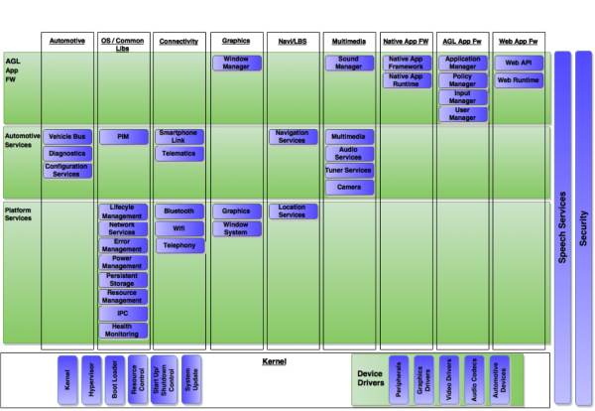
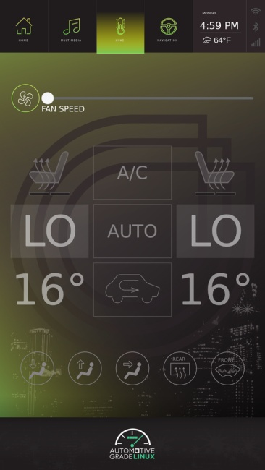
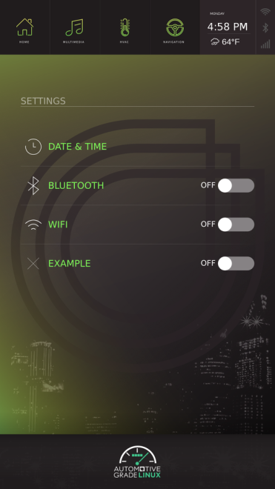
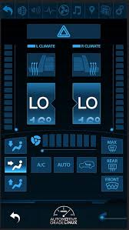
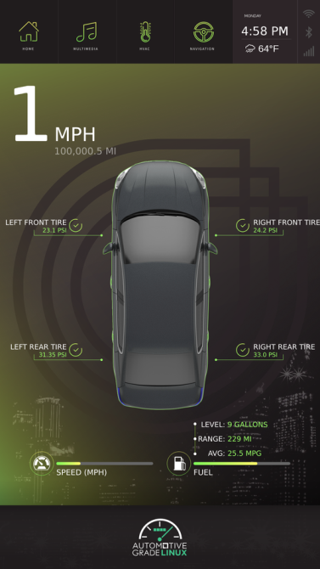
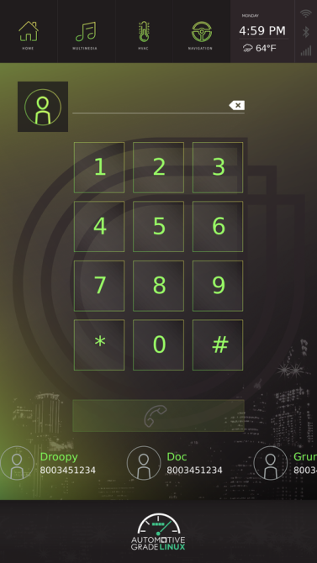
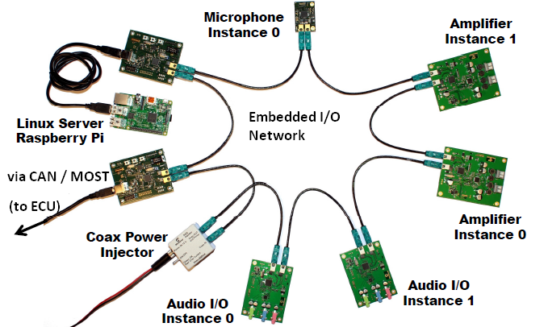
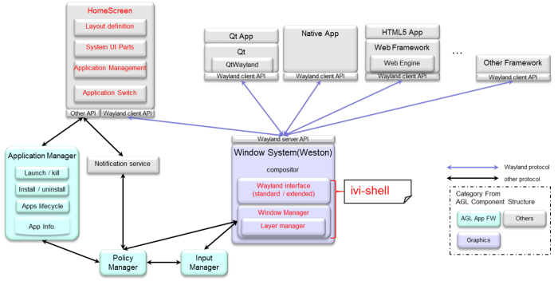






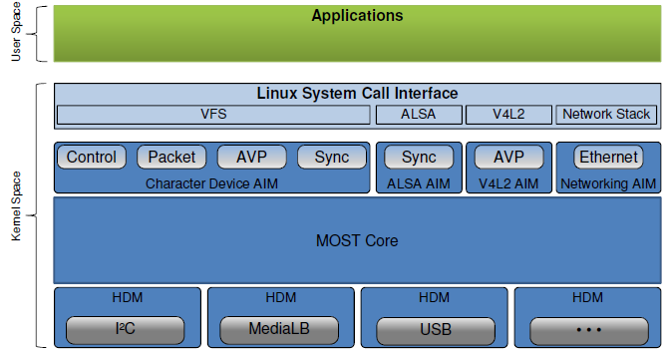
Embedded In-Vehicle Authorization (EiVA)
Nikhil Pandita| 14BME0133| Prof. Vijaya Kumar| MEE308
Introduction
Traditionally, vehicle security used to be all about keys and door locks. However in today’s digital age, it has become essential to incorporate high end technological solutions and advanced optimized computational techniques to ensure world class standards vehicle security and multi factor user authorization.
In this paper, we aspire to address such vehicle security and user cognition procedures , validation & verification problems and describe an efficient and optimal strategy for vehicle-user pair recognition and secure switching over of shared vehicles without the hassles of physical keys.
Scope of the Project
The systems and methods utilize a pool of vehicles available for hire; at least one collection point at which the vehicles are issued; a central reservation system; and a system to verify user identify and reservation status wherein the system receives identifying information from a potential user, communicates the identifying information to the central reservation system which prompts the system to allow access to a reserved vehicle from the pool of vehicles available for hire in response to positive verification of the user and reservation status.
The main objective of this project was to integrate such a point-identity based security and authorization solution with top-of-the-class utility, convenience and rigidness.
Results :
The hardware was successfully emulated on the QEMU emulator, native SD-card mounted image for Raspberry Pi 2.B+ and the Beagelbone-black (over a remote / SSH connection only).
Methodology
A fingerprint Sensor is employed to additionally add to the security layers.
In the current prototype, fingerprint auth is provisionally provided by a smartphones’ in-built sensor.
(The EiVA-AGL User Interface : A few screen-captures)
Conclusion/ Summary
This is a promising project as further development is already ongoing in full swing within the AGL community and the EiVA. Next, Version 3.1, is expected to DEMO at the Tokyo CES, come this May 2017.
The initial setup of apparatus: The SoC x Server x ECU
Acknowledgments :
Further or any research done at all should be duly be accredited to the benevolence bestowed in kind by the following Organizations and Institutions:
These Organizations and Institutions have helped in maintaining, and developing the AGL unified code-base. Furthermore, contribution and progress , new patch versions and releases would be available with the respective AGL-task team.
In our prototype, the ignition starts up from the instance a user inputs his fingerprint onto the embedded sensor in the vehicle dash.
Staging, Downloading and Documentaton:
[ http://14BME0133.github.io/MEE218 ]
References:
The Car Hacker’s Handbook : A guide to automobile penetration testing Craig Smith, Chris Evans (http://www.sae.org/images/books/toc_pdfs/B981.pdf )
CAN specification version 2.0. Robert Bosch GmbH, Stuttgart, Germany, 1991
Homepage of the development partnership Automotive Open System Architecture (AUTOSAR): (http://www.autosar.org)
Getting started with Automotive-Grade Linux : (http://docs.automotivelinux.org)
Hardware and Communication Interfacing on a SoC (Pi 2.B+) (https://www.raspberrypi.org/documentation/hardware)
Working and Architecture :
The following are the schematic reresentations of the AGLs hardware organization and internal architecture.
Contact Details :
Nikhil Pandita [ 14 BME 0133 ]
nikhil.pandita2014@vit.ac.in (+91 -9087858774)

